Slide 1

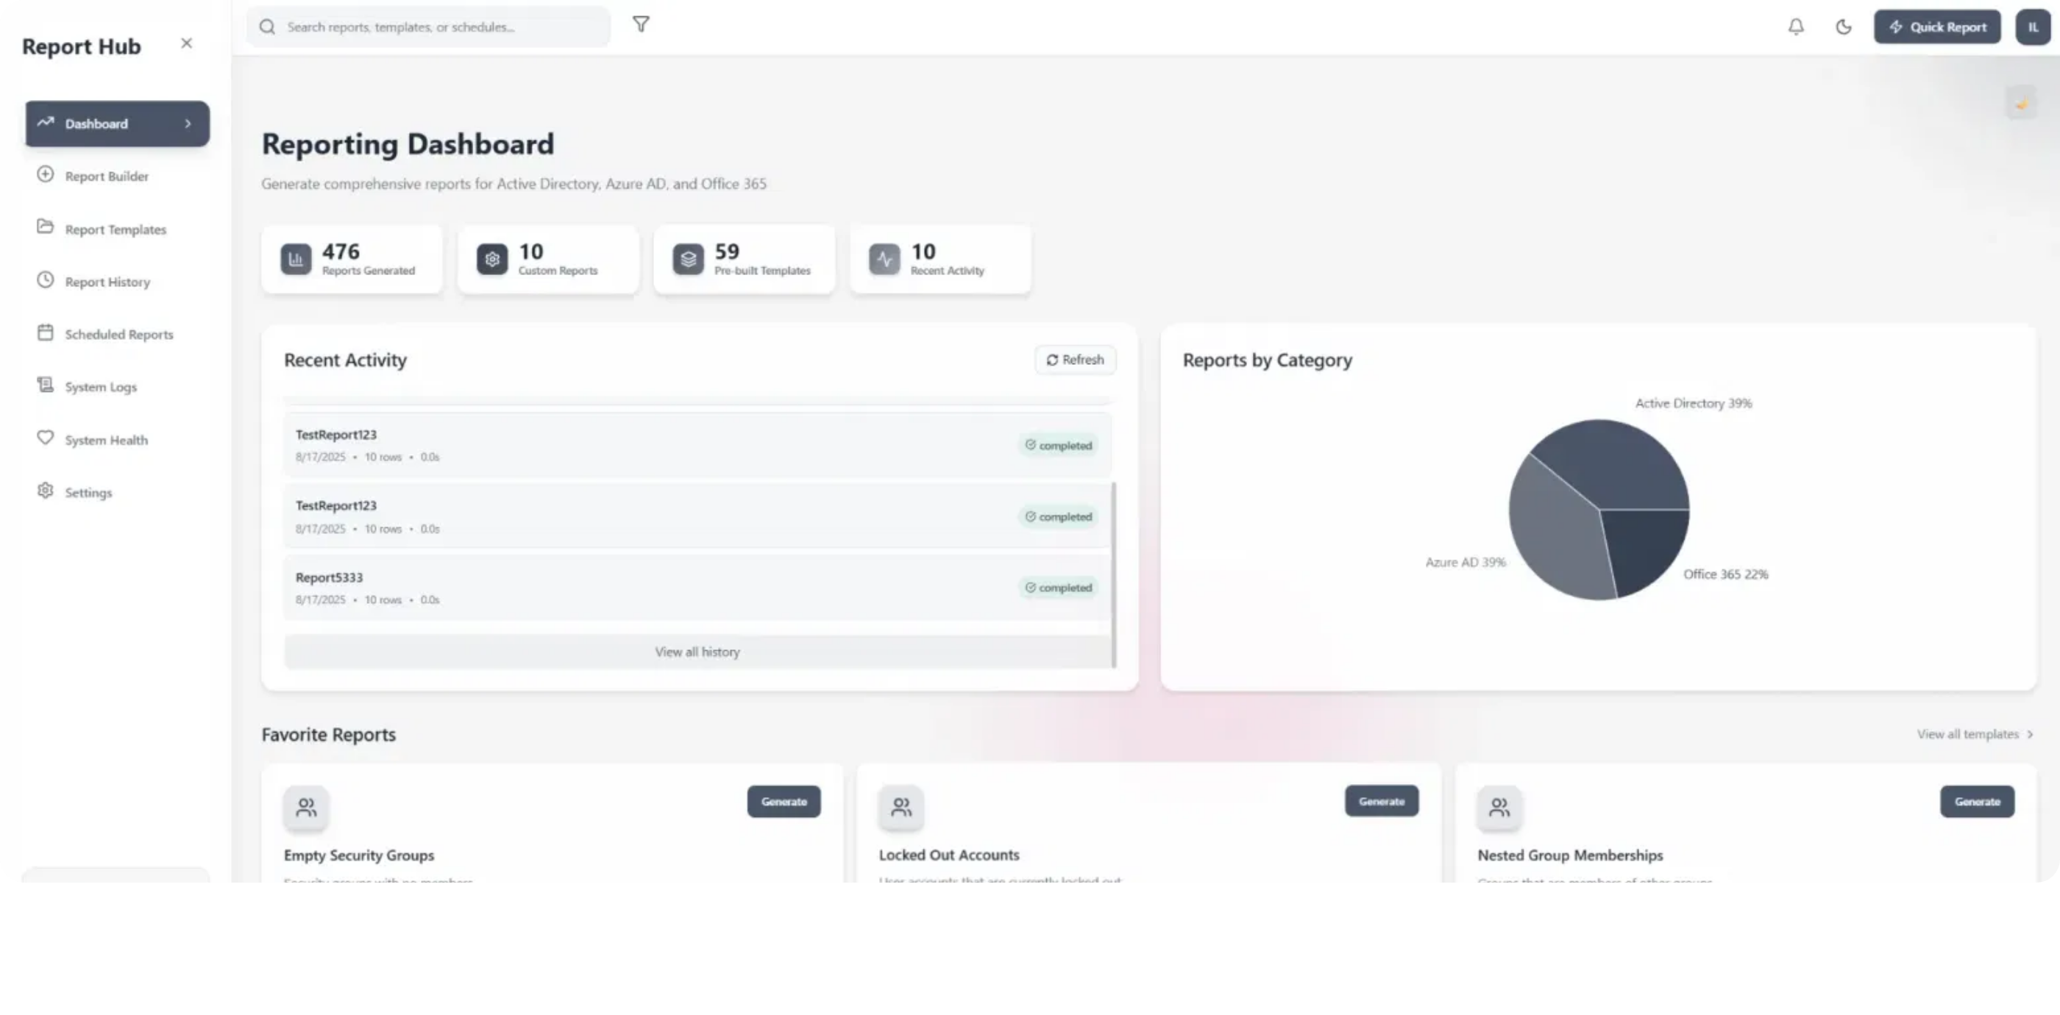
SimpleAdminReporter
Enterprise Identity & Collaboration Reporting Platform
Ilya Fedotov | August 18, 2025

Slide 2

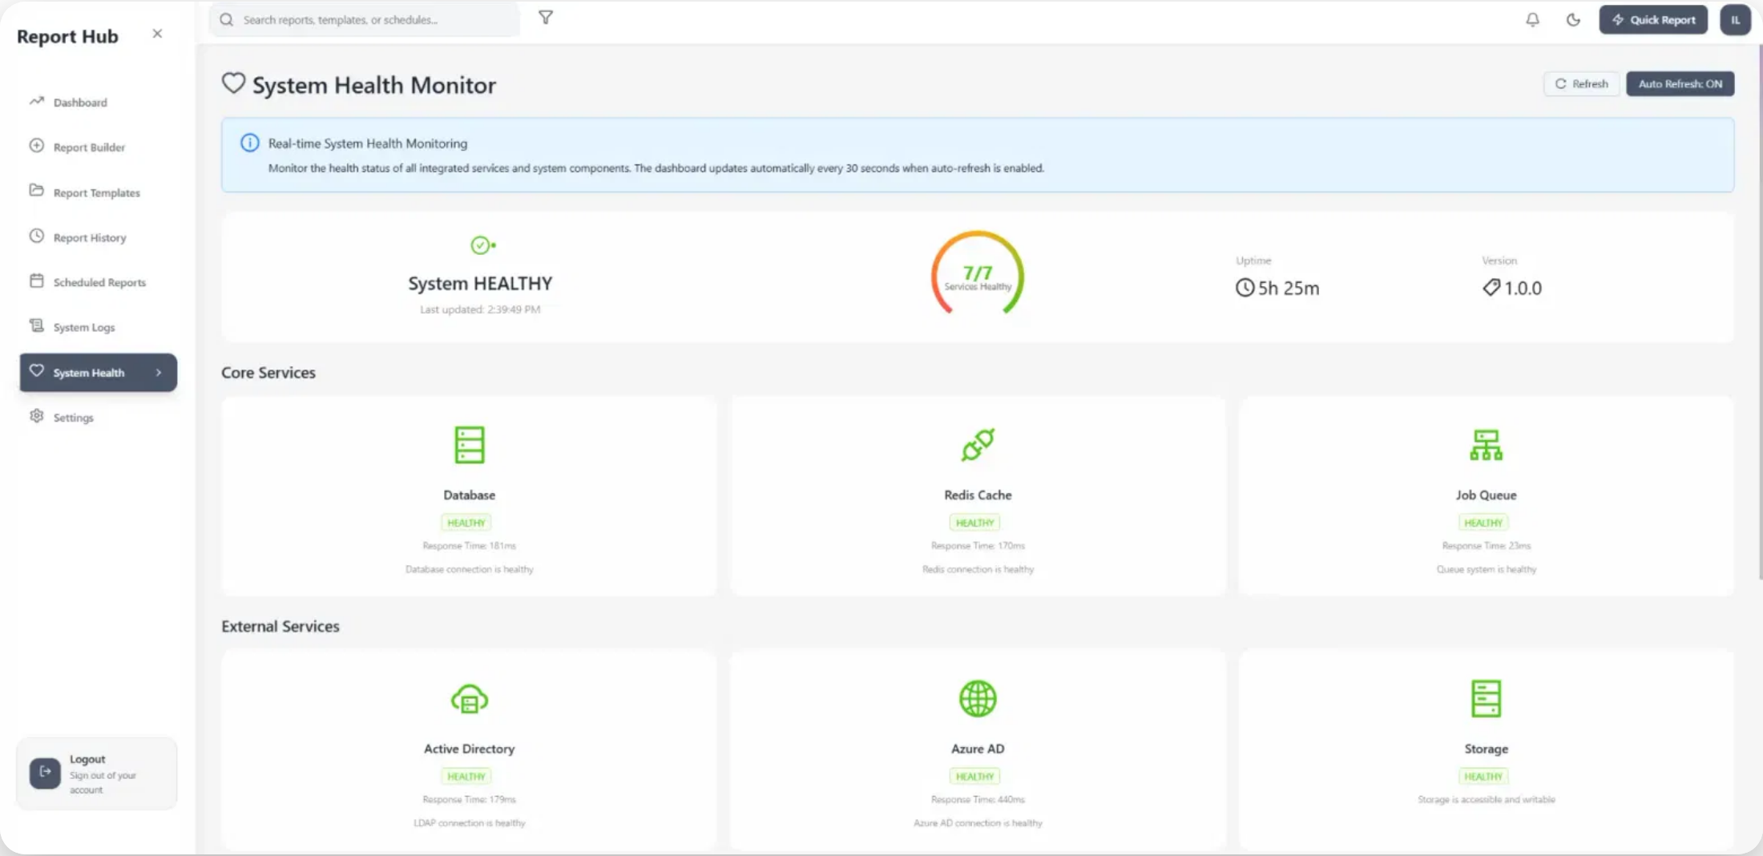

Project Overview
SimpleAdminReporter is a comprehensive, containerized enterprise reporting application designed for IT administrators managing Active Directory, Azure AD, and Office 365 environments.
Unified reporting interface for multiple Microsoft identity platforms
45+ pre-built reports and custom query builder
Modern containerized architecture with React, Node.js, and PostgreSQL
Real-time system health monitoring and comprehensive logging
Enterprise-grade security with multi-source authentication
2

Slide 3


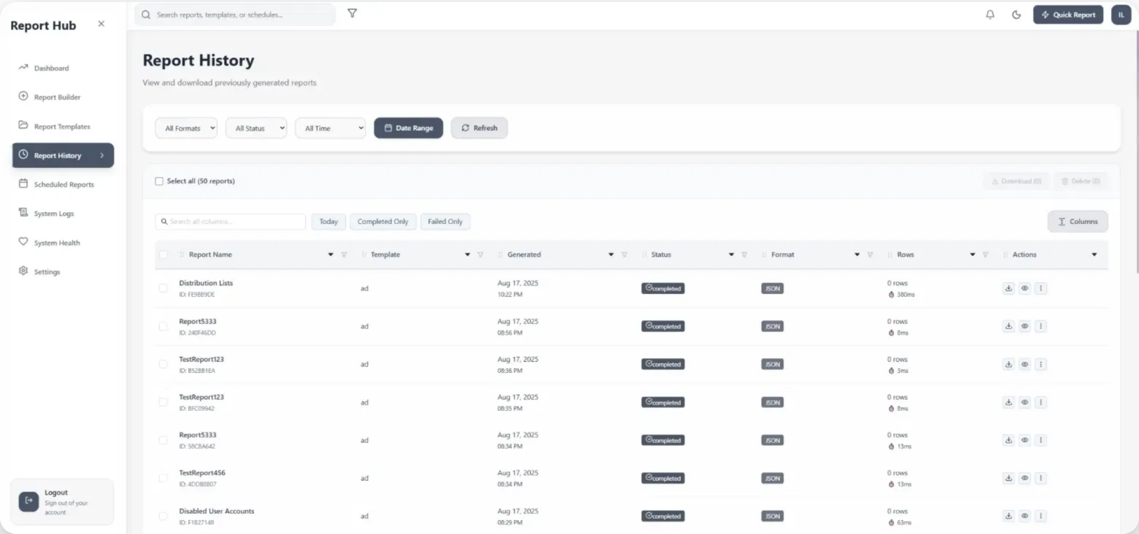




Key Features
Pre-built Reports
Custom Query Builder
45+ ready-to-use reports for Active Directory, Azure AD, and Office 365
Visual drag-and-drop interface for creating custom reports
Real-time Monitoring
Scheduled Reports
Live dashboards with WebSocket updates for system health
Automated report generation and delivery on schedule
Export Options
Enterprise Security
Export to Excel, CSV, and JSON formats with one click
Multi-factor authentication and comprehensive audit logging
3

Slide 4

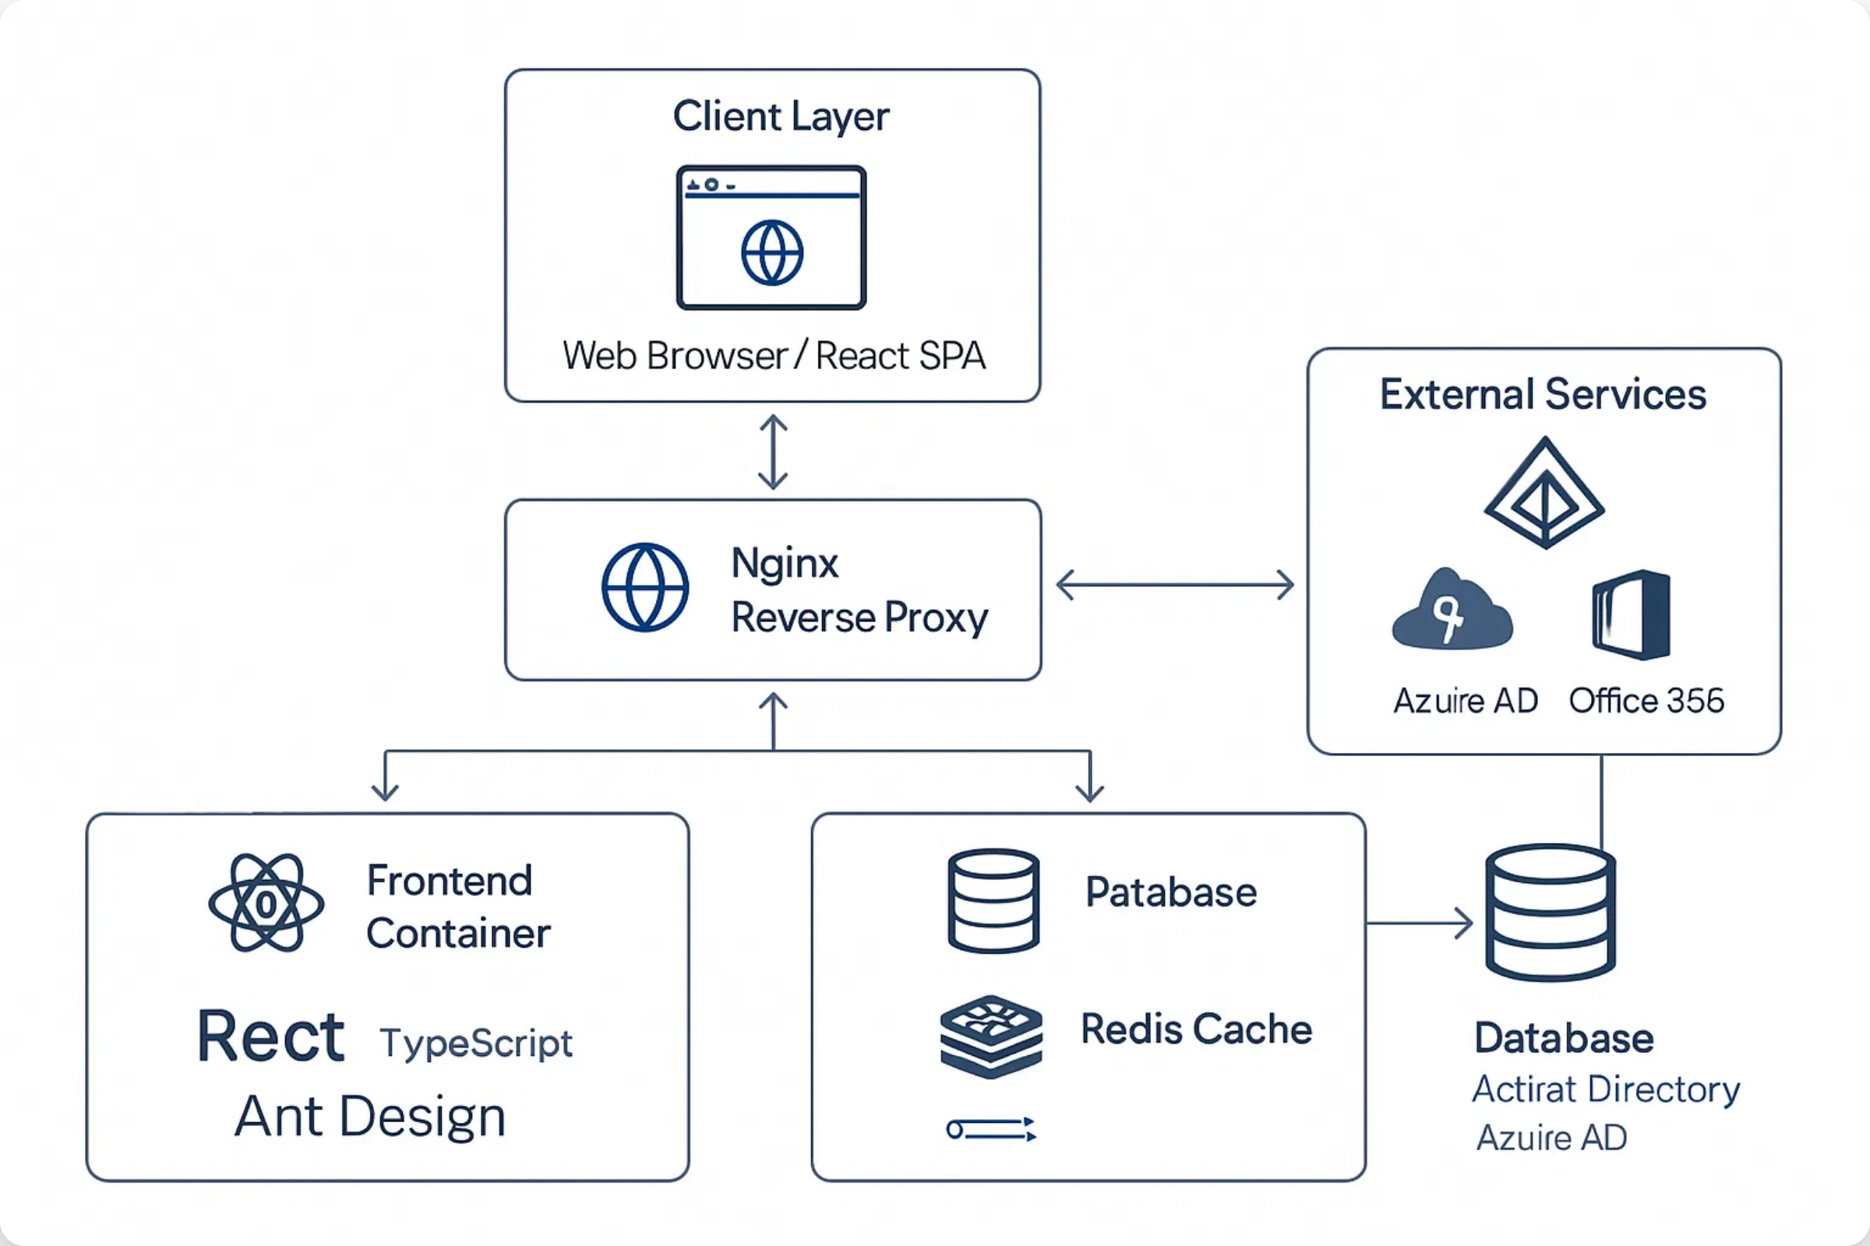



Architecture
SimpleAdminReporter uses a modern, containerized architecture designed for scalability, security, and ease of deployment.
Frontend
Backend
Database & Cache
React 19.1.1
Node.js 20+
PostgreSQL 17
TypeScript 5.9.2
Express.js 5.1.0
Redis 7
Ant Design 5.27.0
TypeScript 5.9.2
TypeORM 0.3.25
4

Slide 5
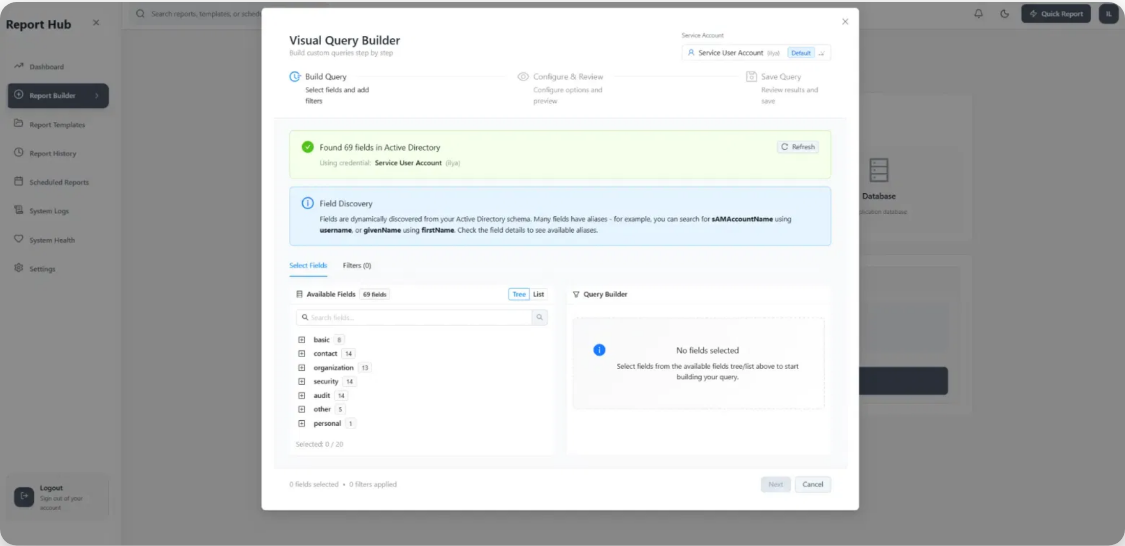




Custom Query Builder
The visual query builder provides an intuitive interface for creating custom reports without requiring technical knowledge of SQL or LDAP queries.
Field discovery automatically detects 69 fields across Active Directory, Azure AD, and Office 365
Drag-and-drop interface for selecting fields and applying filters
Advanced filtering with 10+ operators (equals, contains, greater than, etc.)
Save custom reports as templates for future use
Business Impact
Reduces IT workload by enabling self-service reporting for non-technical users
5

Slide 6
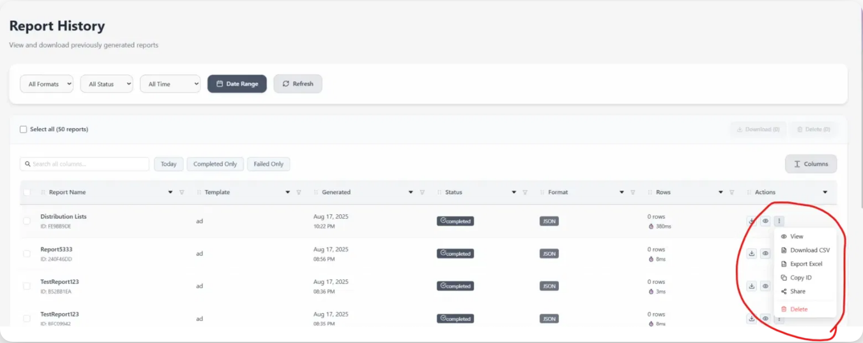



Reports Management
SimpleAdminReporter provides comprehensive tools for managing, scheduling, and exporting reports to meet enterprise compliance and operational needs.
Report History
Scheduled Reports
Complete audit trail of all generated reports with execution metrics and status tracking
Automate report generation with flexible scheduling options and email delivery
Export Options
Sharing
Export to Excel, CSV, and JSON formats with one click for further analysis
Share reports with team members and stakeholders with granular permissions
6

Slide 7

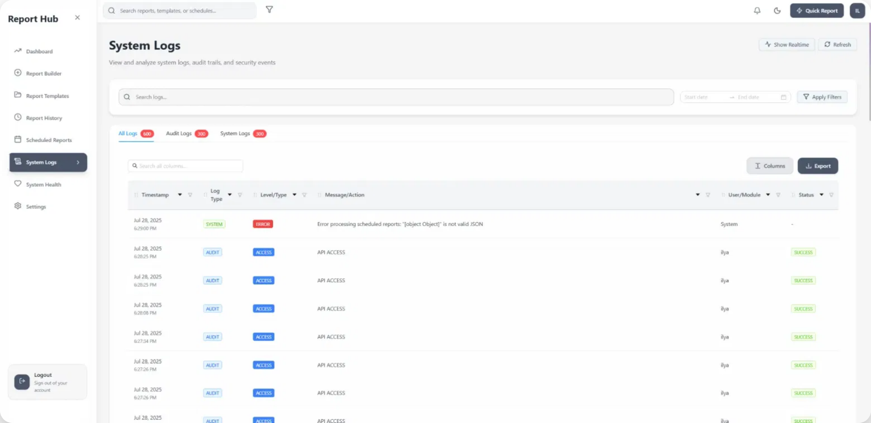





System Monitoring
SimpleAdminReporter includes comprehensive monitoring and logging capabilities to ensure system reliability and security.
Real-time Health Monitoring
Monitor the status of all integrated services and system components with automatic 30-second updates
Comprehensive Logging
Detailed audit trails for security events, user actions, and system operations
Advanced Log Search
Full-text search capabilities across all system logs with filtering options
Operational Benefits
Proactive Issue Detection
Enhanced Security
Performance Insights
7

Slide 8



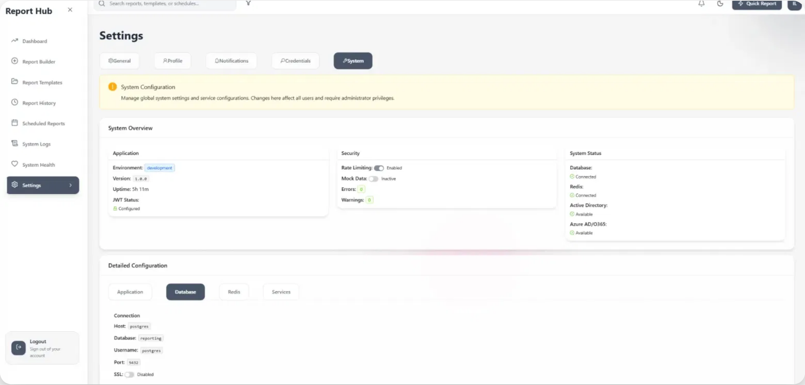


Technical Details
SimpleAdminReporter is built with modern technologies and development practices to ensure reliability, security, and maintainability.
Development
Security
TypeScript throughout frontend and backend
Multi-source authentication (LDAP, Azure AD, JWT)
ESLint/Prettier for code quality
Role-based access control (RBAC)
Comprehensive test coverage (130+ tests)
AES-256-GCM encryption for credentials
GitLab CI/CD pipeline with Docker builds
Comprehensive audit logging
Performance
Deployment
Redis caching with smart invalidation
Docker containerization for all components
Connection pooling for database access
Docker Compose for orchestration
Background processing with Bull Queue
Nginx reverse proxy with TLS termination
Optimized indexes for query performance
Health checks for all services
8

Slide 9






Development Journey
Despite having no prior development experience, I successfully built SimpleAdminReporter using modern AI-powered development tools and methodologies.
Development Timeline
Project Timeline
3 weeks from concept to production-ready system with comprehensive features and testing
3 Weeks
AI-Powered Development Tools
Key Achievement
Built a production-ready enterprise application with zero prior development experience using AI-assisted coding tools
Claude Code
Cursor
Visual Studio Code
Cline/Kilo Code
11

Slide 10

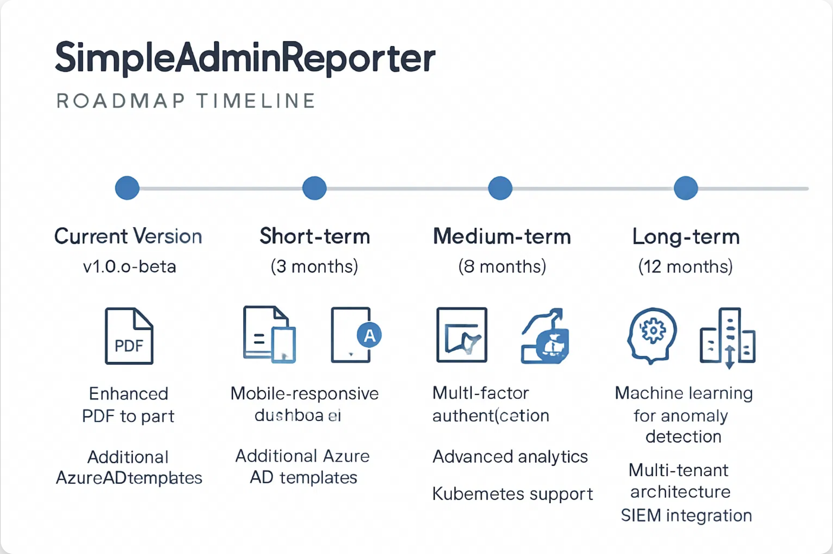












Future Roadmap
SimpleAdminReporter continues to evolve with planned features and improvements to enhance reporting capabilities, security, and user experience.
Short-term (3 months)
Medium-term (6 months)
Long-term (12 months)
Enhanced PDF export
Multi-factor authentication
ML for anomaly detection
Mobile-responsive dashboard
Advanced analytics
Multi-tenant architecture
Additional Azure AD templates
Kubernetes support
SIEM integration
9

Slide 11
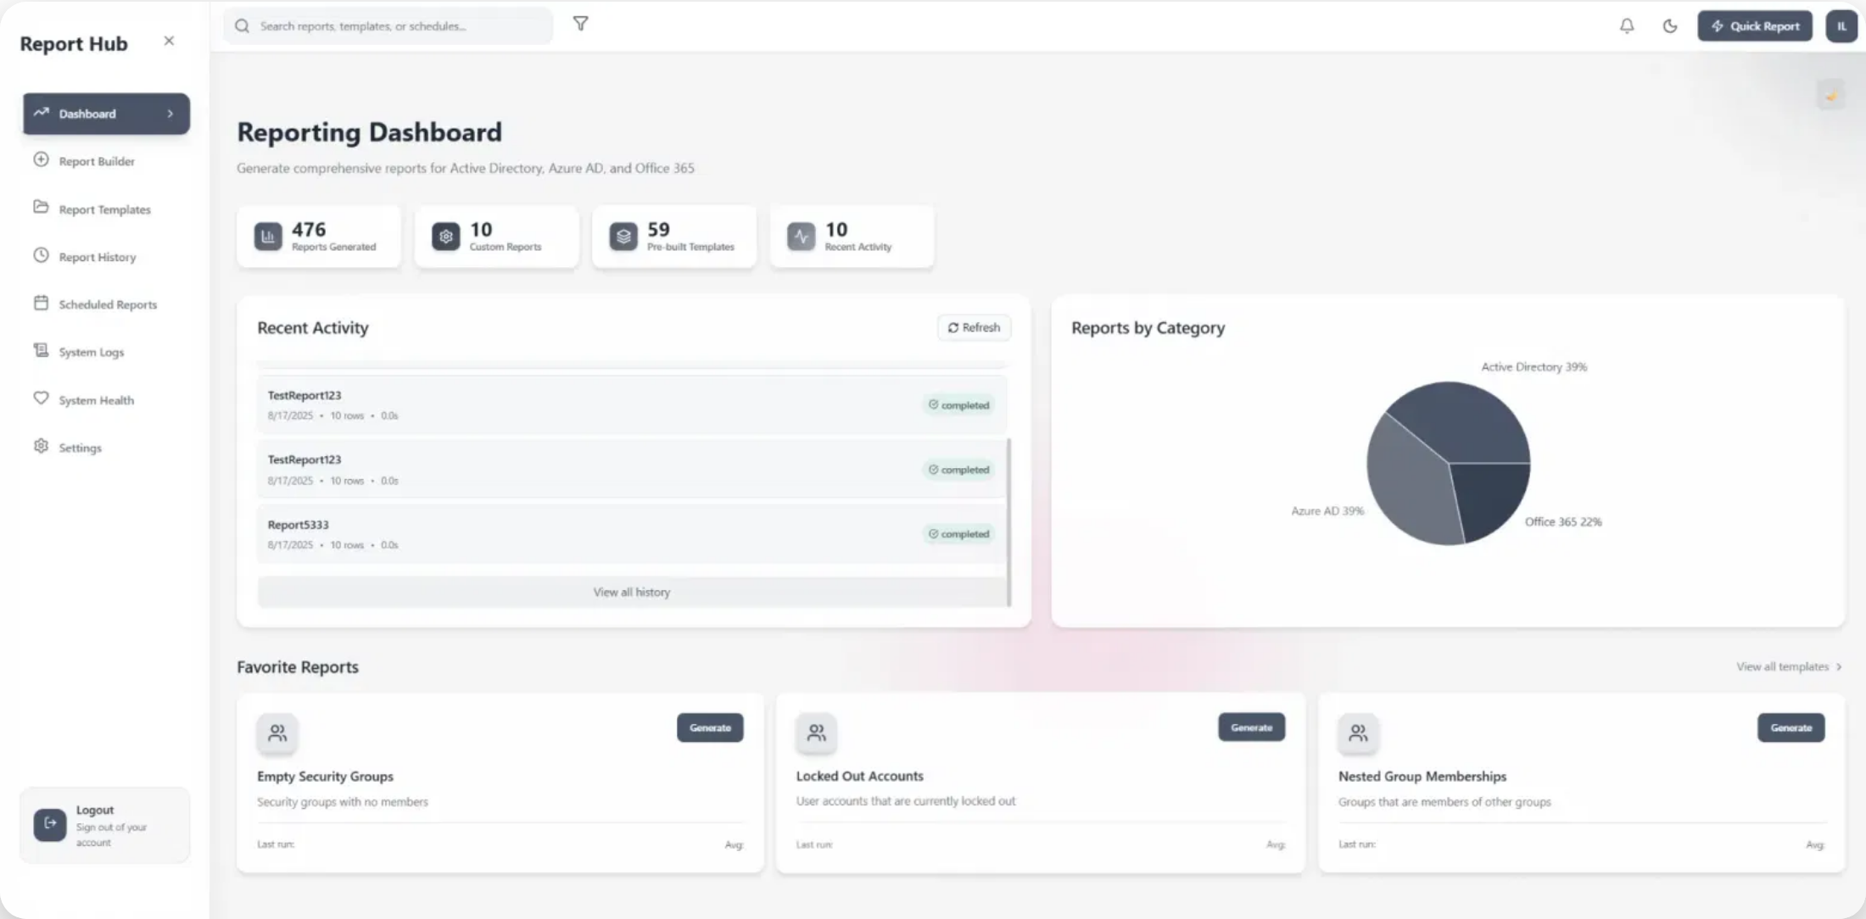


Conclusion
SimpleAdminReporter provides a comprehensive solution for enterprise identity reporting, combining modern technology with practical business value.
Modern architecture solving real business problems with 45+ pre-built reports
Self-service reporting capabilities with visual query builder
Enterprise-grade security and comprehensive monitoring
Containerized deployment for easy installation and scaling
Get Involved
github.com/ilyafedotov-ops/SimpleAdminReporter
"From hours to minutes, from reactive to proactive – transforming how organizations understand their identity landscape."
10

